Slide 1
Sc1015 Mini-project
B137 Group 6
Lim Khai Thung (U2221972E)
Liu Song Tian (U2221915A)
Tan Cai Yee, Eugene (U2220006G)

Slide 2
Diabetes Health Indicators Dataset
- Kaggle

Slide 3
diabetes
A condition where the body does not produce enough insulin to break down glucose (chronic & irreversible)
Prediabetes: blood glucose level is higher than normal, but not high enough to be diagnosed as diabetes

Slide 4
Type 2 diabetes
Caused by lifestyle factors
More common
Notes:
For this project we’ll be targeting only type 2 diabetes because unlink type 1 which is uncontrollable, type 2 diabetes is affected by lifestyle factors. It is also more common and accounts for approximately 90-95% of all diagnosed cases of diabetes.

Slide 5

Interesting statistics (US)
37 millions people in US have diabetes
- > 20% are not aware
Over 1/3 of US adults have prediabetes
- > 80% are not aware
US’s 8th leading cause of death

Slide 6
Problem statement
Predict if a person has a high risk of getting type 2 diabetes based on their current lifestyle and health condition
Despite being red, Mars is actually a cold place

Slide 7
Data preparation
01
02
03
04
Remove duplicates and null data
Combine diabetes & prediabetes into one
Remove entries whose cholesterol was not checked in the last 5 years
Under-sample “No diabetes” to reach a balanced dataset

Slide 8
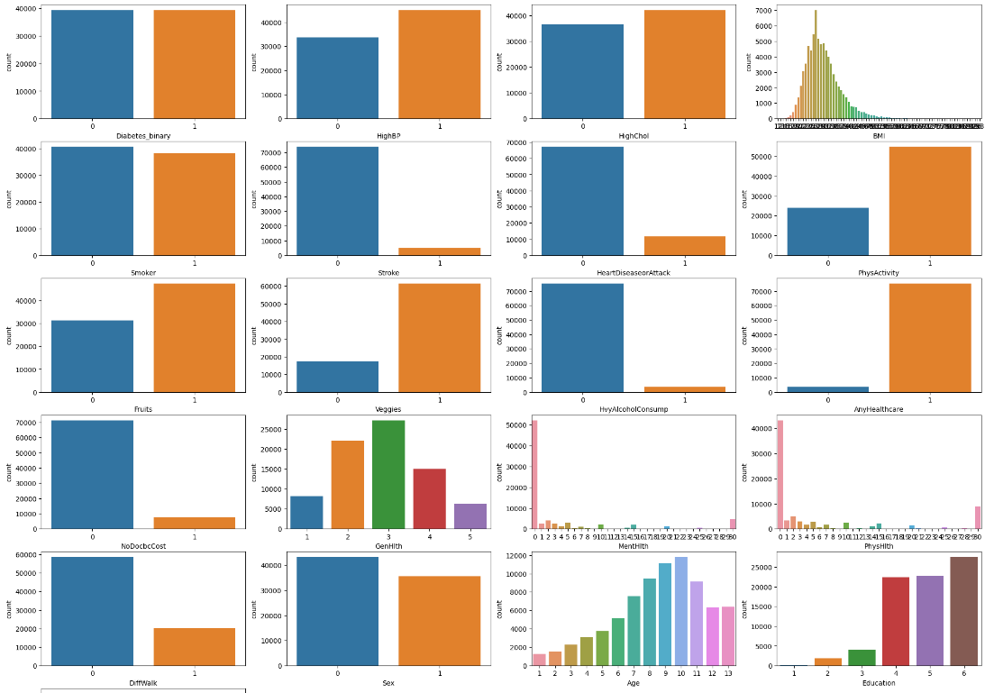
Exploratary data analysis
Too many factors

Slide 9
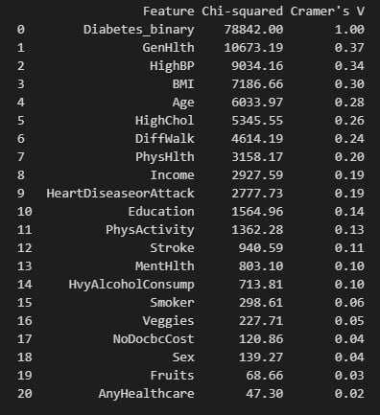
Exploratary data analysis
Feature selection
Chi-squared test
Cramer’s V value
Notes:
We can see that among these factors, some are risk factors of diabetes while others are symptoms or after effect of it. However, there’s an interesting factor among all these, which is level of income. From the data, we found that people of lower income has a higher risk of getting diabetes. The reason for this could be the lack of access to healthy foods, and free and safe physical activity programs. They might also have higher stress level and suffer from isolation, which could lead to diabetes.

Slide 10
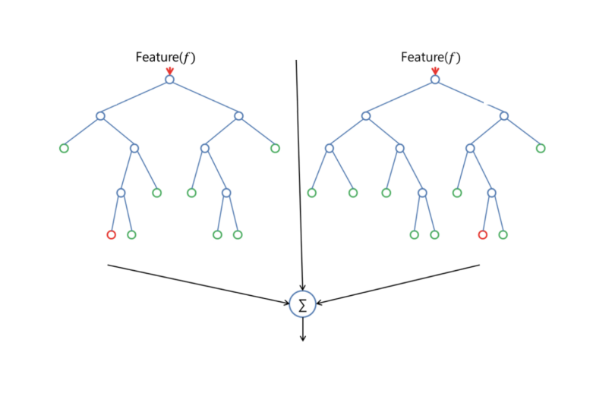
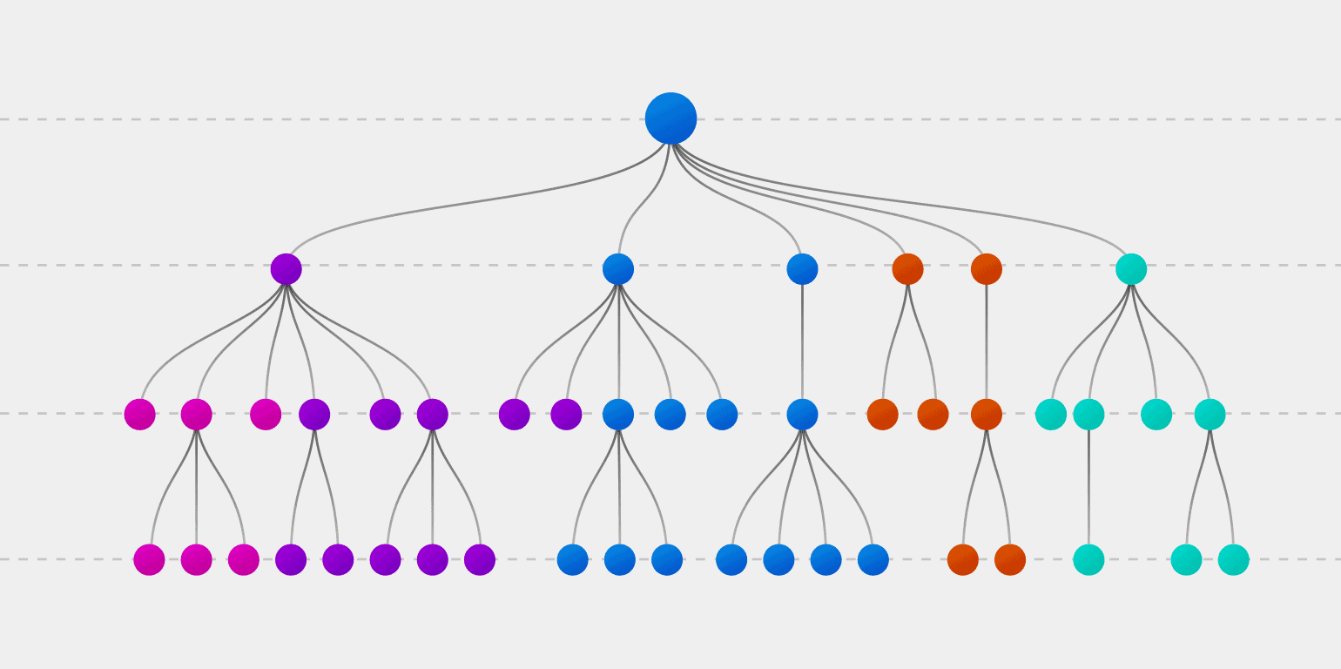
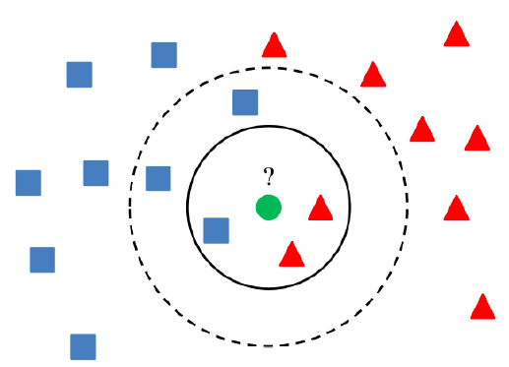
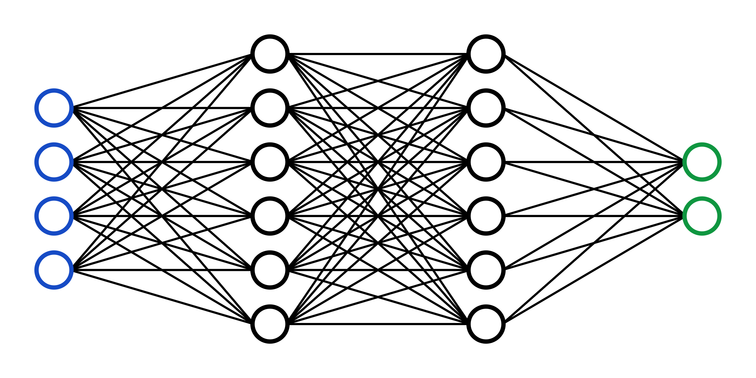
Machine learning
4 models
Random Forest
Decision Tree
K-Nearest Neighbours
Neural Network

Slide 11
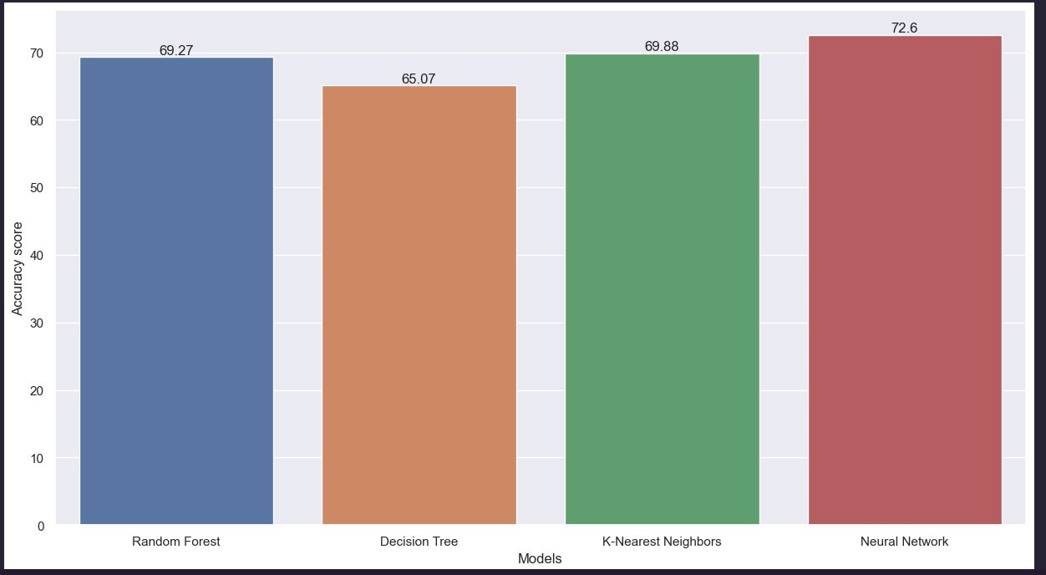
Training with dataset of selected factors

Slide 12
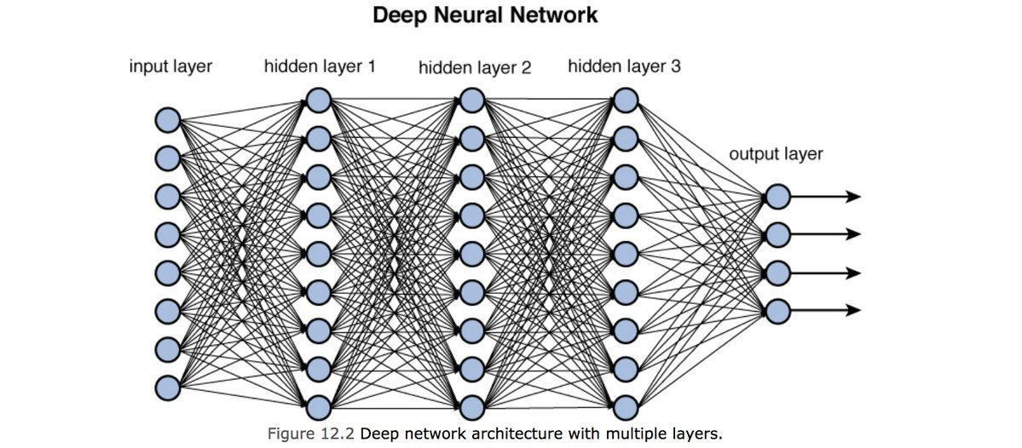
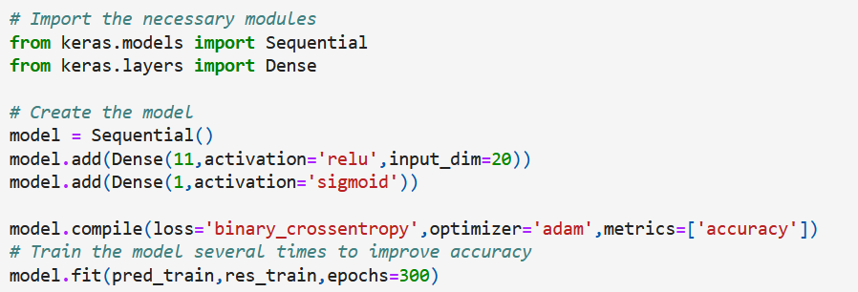
Neural network

Slide 13
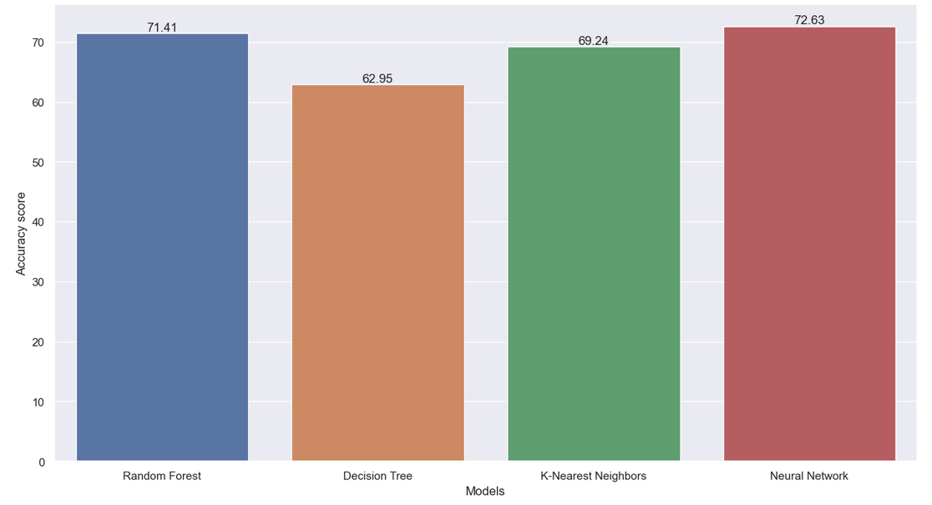
Training with dataset of all factors

Slide 14

project OUTCOME
A person will have a higher risk of getting diabetes if he/she has bad health conditions or lifestyle habits

Slide 15
LEARNING OUTCOME
FEATURE SELECTION METHOD
Using Chi-squared test to obtain Cramer’s V value
New machine learning functions
Random forest
K-nearest neighbours
Neural network

Slide 16
Data driven insights & recommendations
Using neural network, we could conclude that one has to be wary of getting diabetes type 2 if the person has some of the following traits
high blood pressure
high cholesterol level
high BMI
worse general health
worse state of physical health in the past 30 days
high difficulty in walking or climbing stairs
older age
lower income
having coronary heart disease (CHD) or myocardial infarction (MI)

Slide 17
Data driven insights & recommendations
Model training with all factors shows that lifestyle factors collectively have a strong relationship with diabetes
Highly recommended to maintain a healthy lifestyle in our journey of preventing diabetes

Slide 18
Thank you!

